Slide 1

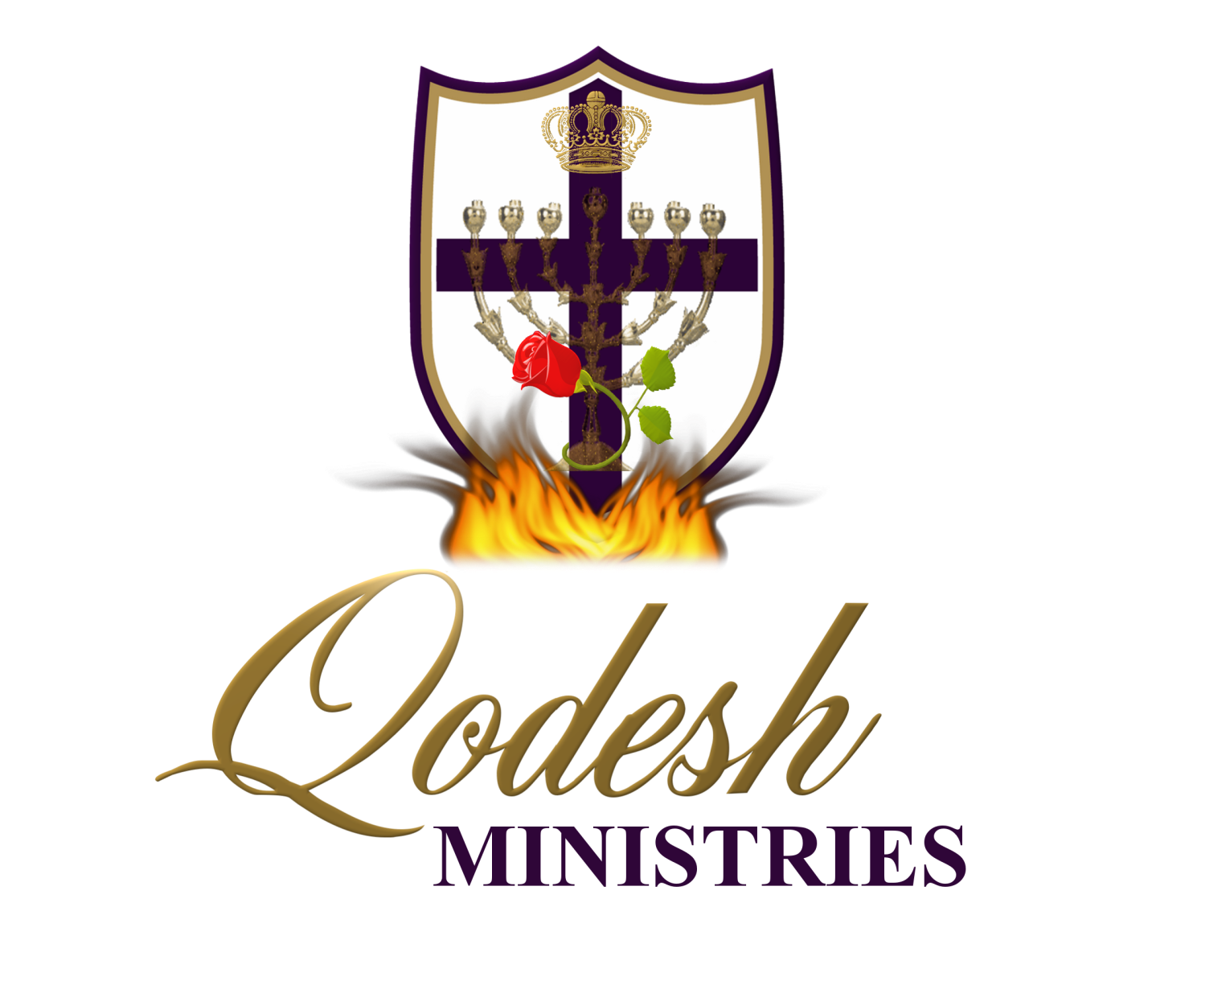

Slide 2
RECOGNITION
THE MESSIANIC PROPHECY BIBLE PROJECT
http://www.messianicbible.com
HEAR O ISRAEL
www.hearoisrael.org
SHEEPFOLD GLEANINGS WRITTEN BY JULIE PARKER
www.sheepfoldgleanings.com
MESSIANIC ISRAEL ALLIANCE
http://www.messianicisrael.com
AZAMRA TORAH FOR OUR TIME – RABBI AVRAHAM GREENBAUM
http://www.azamra.org

Slide 3
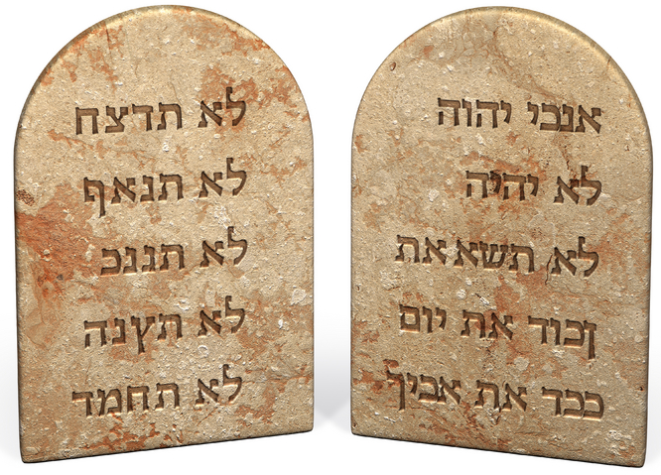
YITHRO“Jethro”
TORAH: Exodus 18:1-20:23
HAFTARAH: Isaiah 6:1-7:6
B’RIT CHADASHAH: Matthew 5:8-20
All references: The Scripture 1998+ unless otherwise noted

Slide 4
YITRO
And Yithro, the priest of Miḏyan, Mosheh’s father-in-law, heard of all that Elohim had done for Mosheh and for Yisra’ĕl His people, that יהוה had brought Yisra’ĕl out of Mitsrayim. (Exodus 18:1)
In this week's parashat, Yitro ("Jethro") visits Moses at the "Mount of God", Mount Sinai. Jethro means "excellence" or "eminence". He was also called Reuel, meaning "friend of God", which may have been a personal name. He was Zipporah's father, and hence Moses' father-in-law who cared for Moses’ family and kept them safe while Moses led the Israelites out of Egypt.
Scripture emphasizes the fact that Jethro was Moses’ father-in-law twelve times in this chapter alone. Could it be that by this repetition Yahweh wanted us to understand “in-law” to mean that Jethro was “in-covenant” and that he put His faith in the God of Abraham, Isaac and Jacob, meaning he followed and obeyed יהוה’s commandments? This would have been a huge transformation for the former Midianite priest.

Slide 5
PRIEST OF MIDYAN
The father of the Midianites was Midian, a son of Avraham by Keturah, his wife, after Sarah died. So, as a Midianite, Yithro was seed of Abraham; but, not “according to the promise” as from Isaac. Yithro was just four generations from Abraham. And, as Abraham would have taught his children the ways of יהוה; by the time Yithro came along, he would have understood Who יהוה is. Yah chose and ordained Yithro for his relationship with Moses and the wise and righteous counsel he would give Moses. And, in this choosing, יהוה provided for Yithro’ s redemption, and that of his house.
As a “Priest of Midian”, Yithro would have led and administered worship there. According to Scripture, Midianites worshipped many mighty ones, including their most powerful mighty one, “ba‟al pe‟or” (lord of light – a sun deity). The rabbis teach that Yithro had understanding regarding many pagan gods. So, why was he givenיהוה righteous wisdom?

Slide 6
WHO WAS YITRO?
Jethro was the family priest and a leader of the Midianites, a people who had originated from Midian, a son of Abraham. This made Moses and Jethro distant cousins.
But with just a little study, we see another meaning for this word. “Kohen”, while Hebrew, has cognitive words from cultures all over the ancient Middle East, like “kahin” or “kahn” in Arabic cultures and dialects. On one hand, we see ongoing references to “priest”; but on the other hand, we see that this word also refers to “king” or “ruler”. The ancient Arabic rulers were often referred to as “priests”. History teaches that Yithro was the “Ruler of Midyan”. Rashi‟s commentary on these verses indicates that, while he lived amidst wealth and comfort, Yithro was prepared to journey into the desert to hear the words of the Torah.
The name Yitro (Jethro), comes from the Hebrew root yeter, meaning abundant or exceedingly abundant. God is able to do exceedingly abundantly (yeter) more than we could ever ask or think or imagine! (Ephesians 3:20)

Slide 7
MAIMONIDES
Taken from “Ripples of Inner Movement”. “During the time of Enosh, mankind made a great error. They said that G-d created stars and spheres with which to control the world. He placed them on high and treated them with honor. Accordingly, it is fit [for man] to praise and glorify [these entities], and to treat them with honor. Thus the worship of false divinities is rooted in a misunderstanding of the fact that G-d influences this world through intermediaries. Our Sages comment: „There is not a blade of grass on this [material] plane that does not have a spiritual force compelling it to grow.‟ Idol worshippers, however, attach independent authority to these intermediaries, thinking they have control over the influence they disperse. In truth, these „gods‟ are merely „an ax in the hand of a chopper,‟ with no importance or will of their own, and therefore it is wrong and forbidden to worship them.” Further he concludes, “By saying Yithro had recognized all the false deities in the world, our Sages implied that he was aware of all the different media through which G-d channels energy to the world. Despite his knowledge of these spiritual powers, he rejected their worship, declaring: „Blessed be G-d. Now I know that G-d is greater than all the deities.‟”

Slide 8
YITHRO PRESENT AT SINAI
And Mosheh sent off his father-in-law, and he went away to his own land. (Exodus 18:27)
In the next chapter, we read that the Children of Israel receive the revelation of the Torah, but first, we are going to read that, Moses sends his father in-law away in verse 27. However, rabbis and Hebrew scholars teach that Yithro was in fact present for the revelation of the Torah? Well, we need to remember this principal; that time does not exist in Torah. All the events that happened and commands that were given from Exodus 18 through Numbers 10:32, including the whole book of Leviticus were part of that one year at Sinai as one event. As we read in And Mosheh said to Ḥoḇaḇ, the son of Reʽuw’ĕl the Miḏyanite, Mosheh’s father-in-law, “We are setting out for the place of which יהוה said, ‘I give it to you.’ Come with us, and we shall do good to you ..“And it shall be, when you go with us, then it shall be that whatever good יהוה does to us, the same we shall do to you.” (Numbers 10:29-32)
It is here that Yithro and his family return to Midian and his son Hobab agrees to remain with Moses and the Children of Israel, and come into the Land with them.

Slide 9
HOBAB
And Ḥeḇer the Qĕynite, of the children of Ḥoḇaḇ the father-in-law of Mosheh, had separated himself from the Qĕynites and pitched his tent near the terebinth tree at Tsaʽanayim, which is beside Qeḏesh. (Judges 4:11)
We see that Yithro becomes a convert, along with his son Hobab. And, even though Yithro (Re‟uwel) returns to the land of his birth, his son goes on to sojourn with Israel and inherit the Land of Promise.
The name “Hobab” (Chet-bet-bet) means “cherished” or literally “whom I have loved”. And, the numeric value of the letters in Hobab is 12 which equals “abadah” or “he who was lost”, Elohim indeed “loves he who was lost”. It‟s also interesting that 12 is the numeric value of the word “dagah” which is “fish”. Fish are a metaphor in Scripture for the Kingdom of Israel.

Slide 10
TORAH LESSON
Torah teaches us the same lesson; that there is one Torah for all Israel and the “stranger” who sojourns with Israel, according to Exodus 12:49, Leviticus 18:26 & 19:33-34 and Number’s 15:15-16 and numerous other verses.
Torah speaks of the “stranger” who sojourns with Israel 70 times and how HaShem loves him and how all Israel is to love him also. In fact, the first verses devoted to this we read last week, as the Children of Israel were leaving Egypt, heading into the wilderness, in Exodus 12:43-49 And יהוה said to Mosheh and Aharon, “This is the law of the Passover: No son of a stranger is to eat of it, but any servant a man has bought for silver, when you have circumcised him, then let him eat of it. ..“All the congregation of Yisra’ĕl are to perform it. “And when a stranger sojourns with you and shall perform the Passover to יהוה, let all his males be circumcised, and then let him come near and perform it, and he shall be as a native of the land. But let no uncircumcised eat of it. “There is one Torah for the native-born and for the stranger who sojourns among you.”

Slide 11
RABBI AVRAHAM GREENBAUM
It is fitting that the parshah which tells of the Giving of the Torah at Mount Sinai is named after Yisro (Jethro), Moses' father-in-law -- a convert as all those who witnessed the Giving of the Torah were "converts". Thus (as noted in the commentary on Parshas SHEMOS) the Covenant at Sinai was accompanied by the three components of conversion: circumcision (Rashi on Ex.12:6), ritual immersion in the waters of the Mikveh (Ex. 19:10) and burned offerings (Ex. 24:5). For before G-d, we are all converts -- GERIM, „dwellers‟ in a land and on an earth that is not ours but G-d's. We are all here only by the grace of G-d, utterly dependent upon His kindness and compassion”.

Slide 12
MOSES DIVORCED??
And Yithro, Mosheh’s father-in-law, took Tsipporah, the wife of Mosheh – after he had sent her back, (Exodus 18:2)
There is an indication here that Moses divorced his wife after their altercation over the circumcision of their sons in 4:24–26. The phrase sent away/back in verse two is shilluach (shin-lamed-lamed-vav-chet, shil-loo’-akh), which according to Strong’s Concordance and Gesenius’ Hebrew Lexicon can refer to divorce. Shilluach is from shalakh (shin-lamed-chet), a basic verb meaning “to send” where in Isaiah 50:1 and Jeremiah 3:1 the prophets use it referring to יהוה’s divorce from the House of Israel/Ephraim.
Though rabbinical commentators Rashi and Hirsch fail to note the possibility of Moses’ divorce, Baal HaTurim notes this possibility in his commentary. Yet Exodus 18:2, YHVH still views Zipporah as Moses’ wife.
Zipporah is never again mentioned in the Torah and in fact we see the possibly divorced Moses marrying another woman (Num 12:1)—apparently a black woman from Ethiopia.

Slide 13
PATTERN OF TWO WIVES
Following the custom of his Horite forefathers, Moses had two wives. The first wife he likely married while in Egypt. She is said to be Kushite (Numbers 12) and for some reason Moses' siblings didn't approve of the marriage. The Horite’s originated in ancient Kush so Moses' marriage to a Kushite isn't unusual.
Moses’ Kushite wife is not named, but she was likely a woman of high rank as the Kushite's were part of, if not the majority of, the ruling classes in Egypt. That would make her the sister of Korah. The first wife was the half-sister (as was Sarah to Abraham) and the second wife was the patrilineal cousin (as was Keturah to Abraham).
“..Miriam and Aaron spoke against Moses because of the Cushite woman he had married: ..” (Numbers 11:35-12:2). The criticism was not racially motivated since all these people were descendants of Noah by Kush (Ham's son) and Aram (Shem's son). Moses’ siblings were angry that he asserted authority over Aaron, his older brother, by marrying Korah's sister and then marrying a Mediante wife. This strengthened Moses' position as ruler.

Slide 14
MOSES SONS
and her two sons, of whom the name of one was Gĕreshom, for he said, “I have been a sojourner in a foreign land,” and the name of the other was Eliʽezer, for he said, “The Elohim of my father was my help, and delivered me from the sword of Pharaoh.” (Exodus 18:3-4)
Moses sons:
“Gereshom” is from the root word “ger” and means “foreigner”, “stranger” or “convert”, whose whole name means “one in exile”.
“Eliezer” literally means “El is my help”.
In naming his sons, Moshe acknowledges that he was also a “sojourner” or “ger” and that it was HaShem who called him out and brought about all the events of his life, and the deliverance of Israel.

Slide 15
CONVERTS
We are all “converts” before Him. The term “ger toshav” for “stranger who sojourns”. “Toshav” comes from the same root as “teshuva” or “to repent” or “turn back” to Elohim. As we read through Genesis we kept seeing the words “stranger” and “sojourner” with regard to Abraham, Isaac and Jacob. In fact, they appear 14 times in Genesis alone in reference to our forefathers and their seed. We are all “ger” or “sojourners” in a land that isn’t ours; but HaShem‟s. We have all come to be “ger toshav”, or “converts” by His “chesed” (“loving kindness” or “mercy”) and “chen” (“favor” or “grace”).
Why? Because, that way no one can claim that the Torah belongs to them by birthright or through ancestral merit. As Elohim chose the Children of Israel to receive the revelation of Torah and to bring the Torah and Elohim’s wisdom to the rest of the world, He made sure to include those sojourning with Israel, including Yithro and his family. In Elohim, there is no room for pride or arrogance.

Slide 16
BURNT OFFERING AND SACRIFICE
And Mosheh told his father-in-law all that יהוה had done to Pharaoh and to the Mitsrites for Yisra’ĕl’s sake, all the hardship that had come upon them on the way, and how יהוה had delivered them. And Yithro rejoiced for all the good which יהוה had done for Yisra’ĕl, ..And Yithro said, “Blessed be יהוה, who has delivered you out of the hand of the Mitsrites and out of the hand of Pharaoh, and who has delivered the people from under the hand of the Mitsrites. “Now I know that יהוה is greater than all the mighty ones, indeed in the matter in which they acted proudly, above them.” Then Yithro, the father-in-law of Mosheh, brought a burnt offering and other slaughterings unto Elohim. And Aharon came with all the elders of Yisra’ĕl to eat bread with the father-in-law of Mosheh before Elohim. (Exodus 18:8-12)
How was Jethro given the understanding and insight to do this unless he had studied Torah? After the sacrifice for his past innocent sins, Aaron and the elders of Israel came and broke bread with Jethro in the presence of יהוה, sealing and confirming that Jethro had indeed come into a covenant relationship with יהוה.

Slide 17
SETTLING DISPUTES
And it came to be, on the next day, that Mosheh sat to rightly rule the people. And the people stood before Mosheh from morning until evening. And when the father-in-law of Mosheh saw all that he did for the people, he said...Stand before Elohim for the people, and you shall bring the matters to Elohim. “And you shall enlighten them concerning the laws and the Torot, and show them the way in which they should walk and the work which they do. “But you yourself, seek out from all the people able men, who fear Elohim, men of truth, hating unfair gain. And place these over them to be rulers of thousands, rulers of hundreds, rulers of fifties, and rulers of tens. .. the hard matters they brought to Mosheh, but they rightly ruled every small matter themselves. (Exodus 18:13-26)
The people needed to be shown how to be led by יהוה and lean on Him for their own needs. He began to teach Moses how to administer good leadership allowing Moses the freedom he needed. This also facilitated a way to educate יהוה ’s people on how to walk in the living principles themselves and learn how to discern the way of holiness through obeying יהוה’s Word.

Slide 18
TYPE OF PERSON
“And you shall enlighten them concerning the laws and the Torot, and show them the way in which they should walk and the work which they do. “But you yourself, seek out from all the people able men, who fear Elohim, men of truth, hating unfair gain. And place these over them to be rulers of thousands, rulers of hundreds, rulers of fifties, and rulers of tens. (Exodus 18:20-21)
First, they must be able men", men of accomplishment. These people would most likely to be wise, have a knowledge of the law, and be able to recognize truth over error in conflict.
Secondly, they must "fear God", the Holy One of Israel. Those who reverence יהוה, will not be afraid of man, or be persuaded by syrupy flattery or angry threats.
Thirdly, they must be contented "men of truth" who despise the temptations that the love of recognition and money bears. The leaders and judges must be those "hating covetousness”
Fourthly, these men would be "rulers of thousands, and rulers of hundreds, rulers of fifties, and rulers of tens

Slide 19
GOVERNING BODY
This was the first formal government established for the Children of Israel. It was practiced until the Romans drove Judah out of the Land; although, they have been governing their worship by this principle right along.
Israel has already begun to re-establish this governing body today:
It starts with the rulers of “tens”. What’s a “ten”? It‟s a “minyon” which represents the congregation. So here we see the rabbi, “Shamash” or under-shepherd.
Rulers of “fifties” which are in Hebrew, “Shoter‟im” or “overseers”.
Rulers of “hundreds” which are “Shaliachim” or “Emissaries”.
And finally, there are rulers of “thousands” which represent the larger “Beit Din” or “House of Judgment” also “Sanhedrin”. The Hebrew word “Sanhedrin” means “Court”, as it equates with the “Supreme Court”.

Slide 20
TIME TO REFLECT
In the third month after the children of Yisra’ĕl had come out of the land of Mitsrayim, on this day they came to the Wilderness of Sinai. (Exodus 19:1)
In the third month after leaving Mitzrayim, to the day, they came into, or arrived at, the wilderness of Sinai. They left “Rephidim” (Reish-fey-yud-dalet-yud-mem), which means “rest” or “to support” or “prop up”. After the crossing of the Reed Sea and the death of the Egyptian army, HaShem brought them to a “place of rest” and gave them water. The numeric value of the letters in “Rephidim” is 344 which equals “la‟shoochah” or “to meditate”. Here they had time to meditate on what Elohim had provided, from deliverance out of bondage, to supporting or sustaining them with manna and water. Then, they enter the “Wilderness of Sinai”. “Wilderness” is that word “midbar” which is also “mouth”, “speech” or “words”. And “Sinai” literally means “thorny” or “rough”. Before they would break camp and move on, they would indeed hear “thorny words” from the mouth of their Creator and Deliverer.

Slide 21
CAMPING AS ONE
For they set out from Rephidim, and had come to the Wilderness of Sinai, and camped in the wilderness. So Yisra’el camped there before the mountain. (Exodus 19:2)
Verse 2 says that they encamped before, or in the face of, the mountain. The Hebrew word here “va‟yichan” or “encamped”, is singular and grammatically implies that they were as one camp, of one heart, as in one person. That’ something to think about.
Can you imagine Israel doing that today, encamping anywhere as one camp or one person? With all the bickering and in-fighting and arguing within just this movement, let alone with Christians and our brother Judah, it’s hard to imagine all Israel uniting together before Elohim. But, that’s the purpose of the “wilderness”; to unite the obedient and separate out the rebellious.

Slide 22
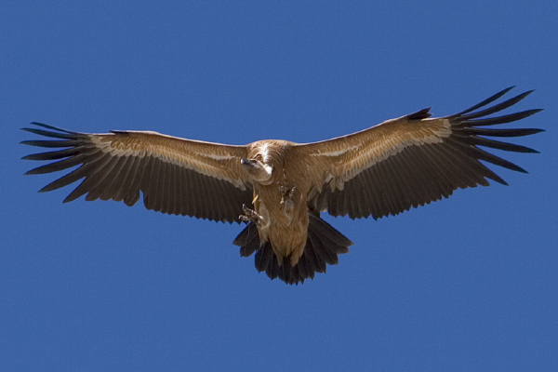
ON VULTURES WINGS
‘You have seen what I did to the Mitsrites, and how I bore you on eagles’ wings and brought you to Myself. (Exodus 19:4)
The eagle (nesher in Hebrew) is protective of its young. While the mother eagle is training the young to fly, she sometimes flies under them with her wings spread out to catch them if they fall. Likewise, God brought out the Jewish People in such a way that He personally watched over their fledgling attempts at living in covenant and communion with Him.
The word nesher (H5404), however, can also be translated as griffin vulture. This vulture flies higher than the eagle, and is wonderfully graceful in the air. This vulture is monogamous and females lay only one egg per year. Both members of the pair participate equally in caring for the egg, and change places every day or two.
The phrase “on vultures’ wings” doesn’t sound poetic to speakers of English. But when one considers this alternative translation, we understand that God, through His miraculous redemption, raised the Jewish People as a nation to spiritual heights that were abundantly above anything in the world.

Slide 23
PROMISE
And Mosheh went up to Elohim, and יהוה called to him from the mountain, saying, “This is what you are to say to the house of Yaʽaqoḇ, and declare to the children of Yisra’ĕl: ..if you diligently obey My voice, and shall guard My covenant, then you shall be My treasured possession above all the peoples – for all the earth is Mine – ‘and you shall be to Me a reign of priests and a set-apart nation.’ ..(Exodus 19:3-6)
יהוה tells Moses, if Israel would obey His voice and accept His covenant offer, they would become:
"a peculiar treasure" (verse 5). Israel would be a precious possession, highly esteemed and jealously guarded by יהוה.
They would become "a kingdom of priests" (verse 6). Further, they would have no earthly king over them, but Israel would be a theocracy (1 Sam. 12:12), and they would rule the heathen.
They would become "a holy nation" (verse 6). Israel would be a set-apart nation, unlike any other nation on earth.

Slide 24
SEPARATE FOR ME
And Mosheh came and called for the elders of the people, and set before them all these words which יהוה commanded him. And all the people answered together and said, “All that יהוה has spoken we shall do.” So Mosheh brought back the words of the people to יהוה. And יהוה said to Mosheh, “See, I am coming to you in the thick cloud, so that the people hear when I speak with you, and believe you forever.” And Mosheh reported the words of the people to יהוה. And יהוה said to Mosheh, “Go to the people and set them apart today and tomorrow. And they shall wash their garments, and shall be prepared by the third day. For on the third day יהוה shall come down upon Mount Sinai before the eyes of all the people. “And you shall make a border for the people all around, saying, ‘Take heed to yourselves that you do not go up to the mountain or touch the border of it. Whoever touches the mountain shall certainly be put to death. ‘Not a hand is to touch it, but he shall certainly be stoned or shot with an arrow, whether man or beast, he shall not live.’ When the trumpet sounds long, let them come near the mountain.” (Exodus 19:7-13)

Slide 25
GREAT SIGN
Moses delivered the message of Elohim's generous promise, with its enticing benefits and advantages, to the leaders WHICH THEY ACCEPTED WITHOUT NOTING THE REQUIREMENTS.
To confirm this Elohim was about to give the people a “great sign” on the third day by coming down in the thick cloud. This is a significant prophetic Scriptural phrase that occurs in relationship to the work of Messiah among his people. For two days (verse 10) the people were to wash and prepare themselves for the third day when יהוה would appear to marry them in covenantal relationship.
This will also result in the people would knowing and believing Moshe from then on. He would not have to perform any more great signs as the only miracles that Moses and Aharon would perform in the wilderness for the next forty years would be only to fulfil the direct needs of the Children of Israel.

Slide 26
SANCTIFY
So יהוה had Moses set-apart “sanctify” the people. Most dictionaries equate “sanctify” with “purify”, “make holy” or “make sinless”. The Hebrew word here is “qadash” which means “to set-apart” or “make separate”. For two days the people were to set themselves apart and wash their clothes. Further, they were not to have marital relations during this “setting apart” of themselves. They were to make themselves “ritually clean” for their meeting with HaShem on the “third day”. This is part of what we, will have to do again in our wilderness experience. The prophet writes in Hoshea 6:1-3 about our awakening to who we are in these last days; ‘Come, and let us turn back to יהוה. For He has torn but He does heal us, He has stricken but He binds us up. ‘After two days He shall revive us, on the third day He shall raise us up, so that we live before Him. ‘So let us know, let us pursue to know יהוה. His going forth is as certain as the morning. And He comes to us like the rain, like the latter rain watering the earth.’ (Hosea 6:1-3)

Slide 27
UNITY
And all the people answered together and said, “All that יהוה has spoken we shall do.” So Mosheh brought back the words of the people to יהוה. (Exodus 19:8)
The commandments became the Israelite’s mission statement. This was a unifying document that gave them a shared purpose. And it is a shared purpose that defines community. Couples, families, congregations, businesses, sports teams, all thrive when rallying around a shared purpose or a goal.
At Mount Sinai, the people have agreed to do…shema, all that יהוה has spoken. They are of one heart and they are eager to enter into this covenant with the One who has delivered them. Shemot 19:8 says that the people answered “together.” That Hebrew word is “yachdav” and its root is “yachad” which means “united.” These words are also related words to “echad” which means “one.”
Unity is the perfect will of the Father, and we need to work towards this vision: Where there is no vision, the people are let loose, But blessed is he who guards the Torah. (Proverbs 29:18)

Slide 28
FIRST MESSIANIC COMMUNITY
The first century believers were very community oriented as they shared life together:
And they were continuing steadfastly in the teaching of the emissaries, and in the fellowship, and in the breaking of bread, and in the prayers. And fear came upon every being, and many wonders and signs were being done through the emissaries. And all those who believed were together, and had all in common, and sold their possessions and property, and divided them among all, as anyone might have need. And day by day, continuing with one mind in the Set-apart Place, and breaking bread from house to house, they ate their food with gladness and simplicity of heart, praising Elohim and having favour with all the people. And the Master added to the assembly those who were being saved, day by day. (Acts 2:42-47)
It is pointed out that the people were of one heart and mind:
And the group of those who believed were of one heart and one being. And no one claimed that any of his possessions was his own, but they had all in common. (Acts 4:32)

Slide 29
COMMUNITY
People congregated in homes as evidenced by Rav Paul in his personal greetings at the end of Romans:
Greet Priscilla and Aqulas, my fellow workers in Messiah יהושע, who risked their own necks for my life, to whom not only I give thanks, but also all the assemblies of the gentiles (Romans 16:3-4)
The Gospel of Messiah יהושע thrived under these conditions of community. The people had a common vision of spreading the good news of the resurrection and of being obedient to the Torah. This is “the conduct worthy of the Gospel of Messiah”:
Only, behave yourselves worthily of the Good News of Messiah, in order that whether I come and see you or am absent, I hear about you, that you stand fast in one spirit, with one being, striving together for the belief of the Good News, without being frightened in any way by those who oppose, which to them truly is a proof of destruction, but to you of deliverance, and that from Elohim. (Philippians 1:27-28)
Our vision should be no different today not forgetting our “first love”:

Slide 30
THIRD DAY
And it came to be, on the third day in the morning, that there were thunders and lightnings, and a thick cloud on the mountain. And the sound of the ram’s horn was very loud, and all the people who were in the camp trembled. And Mosheh brought the people out of the camp to meet with Elohim, and they stood at the foot of the mountain. And Mount Sinai was in smoke, all of it, because יהוה descended upon it in fire. And its smoke went up like the smoke of a furnace, and all the mountain trembled exceedingly. And when the blast of the ram’s horn sounded long and became louder and louder, Mosheh spoke, and Elohim answered him by voice. And יהוה came down upon Mount Sinai, on the top of the mountain. And יהוה called Mosheh to the top of the mountain, and Mosheh went up. And יהוה said to Mosheh, “Go down, and warn the people, lest they break through unto יהוה to see, and many of them fall. “And let the priests who come near יהוה set themselves apart too, lest יהוה break out against them.” ..(Exodus 19:16-25)

Slide 31
THE SYMBOLISM
יהוה stipulated a three-day consecration time for the Bride before she came to meet her Betrothed at the Mountain of יהוה. As in a wedding, the bride makes herself ready. She changes her clothes and washes herself before putting on clean clothes. This is called a mikvah and is for a change of status. On the third day a very long blast was heard and a cloud covered the mountain. The cloud covering became the chuppah or covering under which יהוה came out to meet His bride.
And when the Day of the Festival of Weeks had come, they were all with one mind in one place. And suddenly there came a sound from the heaven, as of a rushing mighty wind, and it filled all the house where they were sitting. And there appeared to them divided tongues, as of fire, and settled on each one of them. And they were all filled with the Set-apart Spirit and began to speak with other tongues, as the Spirit gave them to speak. (Acts 2:1-4)
Thundering’s, fire and tongues of various languages occurred at both Shavuot at Sinai and Pentecost at Jerusalem.

Slide 32
ELOHIM SPOKE
And Elohim spoke all these Words, saying, (Exodus 20:1)
It is here that HaShem Himself gives the “Ten Words” or “Ten Commandments”, the “Ketubah”. The backbone of Torah, the explanation of the two greatest commands, Love HaShem and Love your neighbour as yourself. The people heard all ten from יהוה Himself. Sages proclaim that the universe became hushed, soundless when יהוה spoke.
When the Holy One, blessed be He, presented the Torah at Sinai, not a bird chirped, not a fowl flew, not an ox lowed, not an angel ascended, not a seraph proclaimed Holy. The sea did not roll and no creature made a sound. All of the vast universe was silent and mute. It was then that the Voice went forth and proclaimed, 'I AM YHVH your ELOHIM!' (Shemos Rabbah 29:9). When God revealed Himself to Israel, the world fell silent [holding its breath, so to speak], because this moment was pivotal not only to Israel but to all creation; had Israel not accepted the Torah, the universe would have come to an end [see Shabbos88a] (The Chemosh. Stone edition. page 406).

Slide 33
THE SOUL OF GOD
“I am יהוה your Elohim, who brought you out of the land of Mitsrayim, out of the house of slavery. (Exodus 20:1-2)
The Ten Commandments, begins with an unusual four-letter word: “Anochi”. Verse 2 begins in the Hebrew with; “Anochi יהוה Elohecha…” or literally, “I יהוה your Elohim brought you out of the land of Mitsrayim, out of the house of slavery”. There is no “who” in the Hebrew. The word “Anochi” means “I”. But, “ani” is the common Hebrew pronoun for “I.” So, why did HaShem use “Anochi”?
The letters, Aleph-nun-kaf-yud, are an acronym for “Ana Nafshi Ketovit Yehovit”. This literally means, “My Soul Wrote Gave” in other words, “My Soul I wrote and Gave to You”. In what we‟re about to read, the Ten Commandments, is the very soul (Nafshi – the personal form of Nefesh) of our Creator King. In fact, by inscribing His very “Soul” into His Words, we can see how these Words of His, renew our minds and transform us.

Slide 34
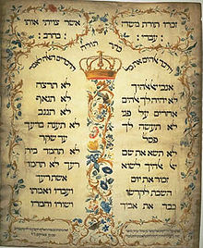
TEN WORDS
NOWHERE in the Hebrew Scriptures will you find the phrase “Ten Commandments”:
And he was there with יהוה forty days and forty nights. He did not eat bread and he did not drink water. And He wrote on the tablets the Words of the covenant, the Ten Words. (Exodus 34:28)
“And He wrote on the tablets according to the first writing, the Ten Words, which יהוה had spoken to you in the mountain from the midst of the fire in the day of the assembly. Then יהוה gave them to me, (Deuteronomy 10:4)
“Words” and “Statements” are somehow more comforting terms than “Commandments” and fit perfectly with the meaning of the word “Torah” which is “Instructions” and not “Law”.

Slide 35
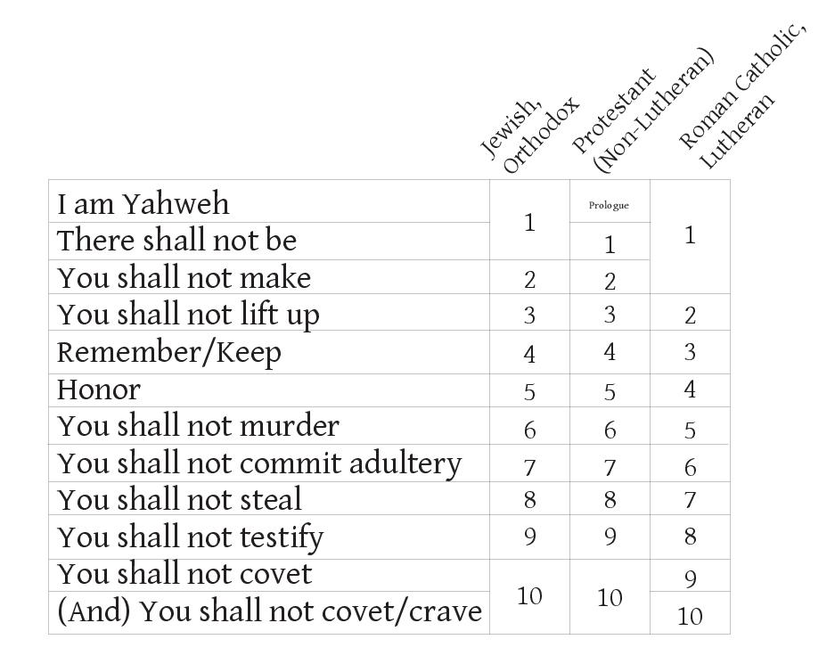
10 WORDS DIAGRAM

Slide 36
TEN STATEMENTS
The first five commandments deal with our relationship with God. The second five deal with our relations with our neighbour.
The rabbis say that all 613 principles can be found in the Ten prophetic statements given at Mount Sinai. Understanding יהוה’s teaching and instruction for marriage and obeying them consecrates the Bride as she enters her walk of redemption, bringing her toward holiness, ready, without spot or wrinkle, to her Bridegroom on His wedding day.
Note: Lest one recoil at the thought of having to keep 613 commandments of the Torah please be advised of the fact that there are approximately 1050 commandments in the Apostolic Scriptures (New Testament)!

Slide 37
CORNER STONE
Remember that the Ten Words are but the mighty cornerstone of the 613 commandments of the Torah. The Jewish rabbis teach that all 613 are implied in the Ten; or that the Ten can be expanded into 613. The Hebrew Scriptures and Jewish writings contain a number of phrases that express the quintessential essence of the Torah. One of these best-known passages naming several of these phrases is in the Jewish Talmud: “Rabbi Simlai said, ‘613 commandments were given to Moses—365 negative mitzvot (commandments), the same as the number of days in the year, and 248 positive mitzvot, the same as the number of parts in a man’s body. David came and reduced them to eleven (Ps 15), Isaiah to six (Isa 33:15), Micah to three (Mic 6:8), Isaiah again to two—“Observe and do righteousness” (Isa 56:1). Then Amos came and reduced them to one, “Seek me and live” (Amos 5:4)—as did Habakkuk, “The righteous one will live by his trusting [or by faith] (Hab 2:4)”’ (Makkot 23b–24a, abridged, from the Jewish New Testament Commentary, by David Stern, p. 565).

Slide 38
SAW THE WORDS
According to Rashi, the entire Ten Words were revealed simultaneously, in a manner that would have been impossible to articulate. What could be the purpose of a communication which could not be cognitively understood? If the Almighty spoke all the Ten Words at once, no one could possibly have even understood one word!! The sages note that perhaps the people did not “hear” at all!! The verse immediately following the Ten Words states:
And all the people saw the thunders, the lightning flashes, the sound of the ram’s horn, and the mountain smoking. And the people saw it, and they trembled and stood at a distance, and said to Mosheh, “You speak with us and we hear, but let not Elohim speak with us, lest we die.” (Exodus 20:18-19)
A more literal translation says that the people were “seeing the voices.” It does not say that the people “heard” the words of Elohim. The text says that they “saw” the voices, the flames, the sound of the shofar and the Mount smoking. These things frightened them, and they asked Moshe to speak that they might instead “hear” from him.

Slide 39
SAW THE SOUNDS
And יהוה said to Mosheh, “Say this to the children of Yisra’ĕl: ‘You yourselves have seen that I have spoken to you from the heavens. (Exodus 20:22)
Rashi explains that when the Torah says that the people “saw the sounds”, they actually “saw” that which is usually “heard”. These were very unusual and divine circumstances. To “see” the glory of the Word of Elohim with our own eyes…does this sound familiar?!!
And the Word became flesh and pitched His tent¹ among us, and we saw His esteem, esteem as of an only brought-forth of a father, complete in favour and truth. (John 1:14)
On the Mountain, we have יהוה speaking in a miraculous way in which the people could “see” what is normally “heard”. It was a completely supernatural experience. No one could possibly doubt that its source was יהוה.

Slide 40
RABBI NOSON WEISZ
Writes, regarding Parsha Yitro, “The purpose of the face-to-face meeting with God at Sinai was to reveal the existence of this spiritually unity that emerges from the shared spiritual source… The people who stood at Mt. Sinai perceived the soul world with absolute clarity, while the physical world receded into the remote distance generally occupied by spiritual matters. A meeting between the Congregation of Israel and God taking place at this high level of spirituality clearly exposed the spiritual connection that exists between all Jews as well as the connection between God and Israel.”.

Slide 41
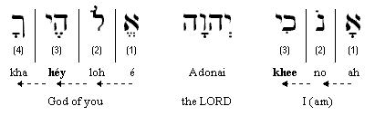
1
“I am the LORD your God.” — Ex. 20:2a:

Slide 42
1ST COMMANMENT
“I am יהוה your Elohim, who brought you out of the land of Mitsrayim, out of the house of slavery. (Exodus 20:2)
Know that there is an Elohim. Don't just believe in Him; seek to know intellectually as well as emotionally, through the design of His creation and genius of Torah. Rabbi Noach Weinberg, zt’l, in his teaching on Parsha Yithro, tells us, “The first of the Ten Commandments is the mitzvah of Emuna, to believe in the one God as the first Cause of all existence, Who constantly creates and sustains all of creation. There is another fundamental concept that is connected to Emuna, that of Bitachon, trust in God… The obligation to have Emuna requires that one believe in the fundamental tenets about God such as First Cause and Divine Providence, whereas Bitachon is applying that belief in practice.”

Slide 43
FIRST WORD
How can we be sure that יהוה intended for this to be the “First Word”? In the oldest Hebrew manuscripts that we have, including the Dead Sea Scrolls, there is an “aleph” (the first letter, also the number 1) in the margin. Other commandments/words are also numbered.
In the early 300’s, the Roman Church excluded the 1st commandment and instead began with the 2nd which they also divided into two. Because they wanted no connection between things that were considered Jewish and Christianity. It was an anti-Semitic decision.
By virtually ignoring the First Word for thousands of years, we have missed a cornerstone of our faith. The First Word impresses on us that “we must know” this Elohim before we can even go on to the rest of the Words/Commandments. First, what is His personal Name? The personal name of יהוה was given to Moses on this very mountain 40 years earlier when he was shepherding sheep. Now Moses the shepherd has returned with the Father’s flock and they will hear for themselves His holy Name.

Slide 44
DESCRIPTION OF יהוה
This First Word is the way יהוה has chosen to define who He is. Why did He choose this description as “your Elohim who brought you out of the land of Egypt, out of the house of bondage”? Why didn’t He say, “I am the Elohim who created the heavens and the earth?” Or, “I am the Elohim who has ultimate power on the earth?”. What else could He have been saying?
• By referring to their bondage in Egypt, He was referencing that He was their covenant Elohim. The experiences they had had leaving Egypt pointed them back to the fulfilment of the covenant promise made to Abram. Knowing this would give them a sense of connection with the patriarchs and the promises given to them. (Genesis 15:12)
יהוה had delivered them from serving Pharaoh and now it was Him they were to be serving (Exodus 9:13)
He says, “I am YOUR Elohim”….your Master. He had redeemed them from slavery in order that they might become His bride.

Slide 45
PARABLE: RAMBAM
“Imagine a king who comes to a province and is not recognized. His courtiers urge him to start giving orders, since he is a king. Yet, the king hesitates. If they do not accept my sovereignty, he asks, why would they obey my commandments? God faced the same question at Sinai. If the Israelites are unsure of my existence, God wondered, why would they obey My laws? Therefore, the first commandment concerns not action, but apprehension. It addresses our internal sensibility, not our external behaviour. It asks not for obedience, but for relationship, and relationship is the foundation of the Torah.”

Slide 46
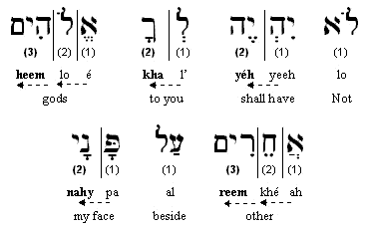
2
“Thou shalt have no other gods before me.”— Ex. 20:3:

Slide 47
2ND COMMANDMENT
“You have no other mighty ones against My face. “You do not make for yourself a carved image, or any likeness of that which is in the heavens above, or which is in the earth beneath, or which is in the waters under the earth, you do not bow down to them nor serve them. For I ..am a jealous Ěl, visiting the crookedness of the fathers on the children to the third and fourth generations of those who hate Me, but showing kindness to thousands, to those who love Me and guard My commands. (Exodus 20:3-6)
We are not to commit idolatry. This means making and worshipping carved or molten images. We are not to practice idolatry and say it is unto Him. The Hebrew words in Torah here are “phasal” (fey-samech-lamed) for “carved (or graven) image”, which means “carved”, “molded”, “fashioned” or “made”. And, “te‟moonah” (tav-mem-yud-nun-hey) for “likeness” which is “appearance” or “image”.
“Therefore, diligently guard yourselves, for you saw no form when יהוה spoke to you at Ḥorĕḇ out of the midst of the fire, lest you should do corruptly and shall make for yourselves a carved image in the form of any figure – the likeness of male or female, (Deuteronomy 4:15-16)

Slide 48
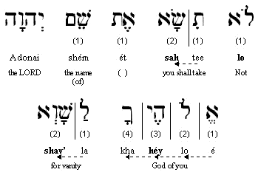
3
“Thou shalt not take the name of the LORD your God in vain”
— Ex. 20:7a :

Slide 49
3RD COMMANDMENT
“You do not bring¹ the Name of יהוה your Elohim to naught, for יהוה does not leave the one unpunished who brings His Name to naught. (Exodus 20:7)
Do not make, or cause, His name to mean, or become, “nothing”. We are not to use substitute names or titles in place of His Set-Apart Name “יהוה ”, in our prayers and intimate time.
Likewise, we are not to diminish His Name by using it commonly, as that too is part of making His name nothing. Terms like “Adon” or “Adonai” (Master / my Master) are fine to use in everyday conversation. Jews also use “HaShem” in this same context. In prayer and study, they read יהוה . They revere His Name to such an extent that they don’t speak it openly. That is reverence and not a character flaw, as some would have you believe. He specifically says that He will not leave those who bring His Name to naught unpunished. We should be careful in all aspects here.

Slide 50
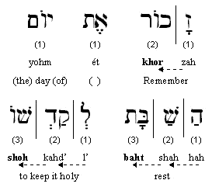
4
Remember the Sabbath day, to keep it holy” — Ex. 20:8:

Slide 51
4TH COMMANDMENT
“Remember the Sabbath day, to set it apart. “Six days you labour, and shall do all your work, but the seventh day is a Sabbath¹ of יהוה your Elohim. You do not do any work – you, nor your son, nor your daughter, nor your male servant, nor your female servant, nor your cattle, nor your stranger who is within your gates. Footnote: “For in six days יהוה made the heavens and the earth, the sea, and all that is in them, and rested the seventh day. Therefore יהוה blessed the Sabbath day and set it apart. (Exodus 20:8-11)
יהוה is really clear here that the Sabbath is the seventh day, because He blessed it and set it apart. Man does not have the authority or permission to change it. “Remember the Sabbath …”? Why did he only say “remember” with this commandment and not the others?

Slide 52
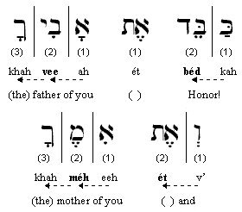
5
“Honor thy father and thy mother” — Ex. 20:12a:

Slide 53
5TH COMMANDMENT
“Respect your father and your mother, so that your days are prolonged upon the soil which יהוה your Elohim is giving you. (Exodus 20:12)
The fifth commandment, was included among those that deal with the honour and reverence to be shown to the Almighty. This is revealing. When people honour their parents, "God regards it as if they honour Him, for, as the Sages express it: There are three partners in a human being: God, father, and mother. If someone honours his parents, God considers it as if he had honoured Him. But if not, God says, I did well not to dwell among them, for if I had dwelled among them they would have tormented Me, as well" (Kiddushin 30b-31a). Our obligation to Elohim requires us, whatever our age, upbringing, or station in life, to show respect and honour to our parents, whether the parents deserve it or not. Parents should be honoured for (1) their age, experience and wisdom, (2) their care and contributions, (3) their love and affection (4) because they are instruments (so to speak) who were created before their children, and through whom their children were given life and brought into the world, and (5) because it honours and extols the Almighty.

Slide 54
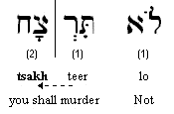
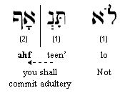
6/7
“Thou Shalt Not Kill” — Ex. 20:
“Thou shalt not commit adultery” — Ex. 20:14:

Slide 55
6TH & 7TH COMMANDMENT
“You do not murder. (Exodus 20:13)
The Hebrew word here is “ratsach” (reish-tzadee-chet), which means to “break in pieces” and has the connotation of pre-meditated murder or assassination. In all of Jewish literature, it has always been taught to include hatred and desiring to see someone harmed.
“You do not murder. (Exodus 20:13)
The Hebrew word for “adultery” here is “tena‟af”. It is made up of two words “ten” and “af” which translates as “giving anger”. This sin destroys the relationship between husband and wife and it is the opposite of loving your neighbor as yourself. It also means “idolatry” or “idolatrous worship” as referenced in “And I saw that for all the causes for which backsliding Yisra’ĕl had committed adultery, I had put her away and given her a certificate of divorce; yet her treacherous sister Yehuḏah did not fear, but went and committed whoring too. (Jeremiah 3:8)

Slide 56
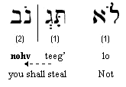
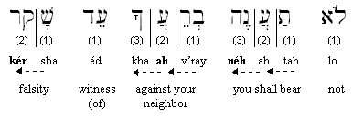
8/9
“Thou shalt not steal” — Ex. 20:15:
“Thou shalt not bear false witness against thy neighbor”— Ex. 20:16:

Slide 57
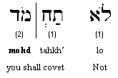
10
“Thou shalt not covet…” — Ex. 20:17a

Slide 58
8TH, 9TH & 10TH COMMANDMENT
“You do not steal. (Exodus 20:15)
This refers to more than money or property. The rabbis teach, just as Gesenius‟ Lexicon and Brown, Driver, Briggs add that this also refers to deceiving someone, kidnapping or taking that which pertains to someone's livelihood.
“You do not bear false witness against your neighbour. (Exodus 20:16)
This sin perverts a verdict and destroys justice.
“You do not covet your neighbour’s house, you do not covet your neighbour’s wife, nor his male servant, nor his female servant, nor his ox, nor his donkey, or whatever belongs to your neighbour.” (Exodus 20:17)
The Hebrew word here is “chamad” which means to “desire” or “delight in”. The connotation is that to “delight in” means also to “fantasize about” having that which is your neighbour's; thereby, causing you to dislike or, according to Scripture, “hate” or “loathe” that which is yours. It creates or sets up idolatry / adultery in your heart for whatever is someone else's.

Slide 59
I HAVE SPOKEN TO YOU
And יהוה said to Mosheh, “Say this to the children of Yisra’ĕl: ‘You yourselves have seen that I have spoken to you from the heavens. ‘You do not make besides Me mighty ones of silver, and you do not make mighty ones of gold for yourselves. (Exodus 20:22-23)
The word here for spoken is “dabar” or “to have words with”, as well as “to lead” or “guide”. “You do not make besides Me mighty ones of silver, and you do not make mighty ones of gold for yourselves.” While this is a reminder; it is also in addition to the Second Commandment. Other translations read, “You shall not make with me gods of silver,” etc. The Hebrew word used here as “besides” or “with” is “eetee” (aleph-tav-yud) and means “neighboring” or “next to” or “with”. Also, we do not have the word “elohim”, but “eloah” which is singular. So, what‟s he saying? “You do not make an “eloah” (mighty one) out of silver or gold that which is next to Me”. In other words, don’t make idols out of יהוה in the image of man, or the “malachim” (messengers - angels). I’m talking statues, pictures or any image, “phasal” or “te‟moonah”.

Slide 60
MAKE AN ALTAR
‘Make an altar of earth for Me, ... ‘And if you make Me an altar of stone, do not build it of cut stone, for if you use your chisel on it, you have profaned it. ‘Nor do you go up by steps to My altar, lest your nakedness be exposed on it.’ (Exodus 20:24-26)
Elohim prefers an altar of earth, Adam/man. We become the altar for that which we worship, because of the sacrifices/offerings we make; our time, energies, and the “bulls of our lips”. If that altar is stone, then we are not to “chisel” it (put our marks on it) or fashion it with our works. On His altar we obey Torah. Remember what Yeshayahu said in Chapter 51:1; “Look to the rock you were hewn from, and to the hole of the pit you were dug from.” It‟s HaShem‟s altar, not our work. We place our “works” on His altar. We give them to Him. We do not ascend His altar by steps. The Hebrew here is “ma‟aleh” (mem-ayin-lamed-hey) which means “steps” or “stairs”, and also “stage”. In other words, we,re not to ascend His altar as if “going up on a stage”. It‟s not for show, lest our nakedness (ervah) or “shame” be uncovered or revealed.

Slide 61
BRIDE AND BRIDEGROOM
Israel as the bride andיהוה as the Bridegroom, it turns the Mosaic covenant into the “ketubah” or the wedding covenant. Here are the steps:
We have already read of the intentions made by the Groom in the “I wills”: "Therefore, say to the people of Isra'el: 'I am Adonai. I will free you from ..the Egyptians, .. I will take you as my people, and I will be your God. ..(Exodus 6:6-7)
The bride is set apart in order to prepare for the wedding. Israel was set apart as she was brought into the wilderness (Numbers – place of the word) where her character was transformed. This is also called sanctification, or the process of being made holy. For Israel, this was to happen during the period we know as the “Counting of the Omer”
The formal proposal: ‘And now, if you diligently obey My voice, and shall guard My covenant, then you shall be My treasured possession above all the peoples – for all the earth is Mine – (Exodus 19:5)

Slide 62
BRIDE AND BRIDEGROOM CON’T
The bride’s answer to the proposal: And all the people answered together and said, “All that יהוה has spoken we shall do.” So Mosheh brought back the words of the people to יהוה. (Exodus 19:8)
Preparation for the special day: And יהוה said to Mosheh, “Go to the people and set them apart today and tomorrow. And they shall wash their garments, (Exodus 19:10)
The Groom comes down and stands beneath the wedding canopy (chuppah) And it came to be, on the third day in the morning, that there were thunders and lightnings, and a thick cloud on the mountain. And the sound of the ram’s horn was very loud, and all the people who were in the camp trembled. (Exodus 19:16)
The Groom presents the wedding proposal through the friend of the bridegroom (Moses): And Mosheh brought the people out of the camp to meet with Elohim, and they stood at the foot of the mountain. (Exodus 19:17)

Slide 63
BRIDE AND BRIDEGROOM CON’T
A shofar blast will announce the special day: And when the blast of the ram’s horn sounded long and became louder and louder, Mosheh spoke, and Elohim answered him by voice. (Exodus 19:19)
The marriage contract (ketubah) is given to the bride. It includes all the conditions of the marriage covenant. (Exodus 20)
The token of the covenant symbolizing its permanence: ‘And the children of Yisra’ĕl shall guard the Sabbath, to observe the Sabbath throughout their generations as an everlasting covenant. (Exodus 31:16)
Thus ended the first stage of the marriage covenant called the betrothal. During the betrothal you are legally married to your spouse, but you do not yet physically dwell with them.

Slide 64
JEREMIAH
Jeremiah provides us with more insights into the betrothal of Israel in the wilderness:
And the word of יהוה came to me, saying, “Go, and you shall cry in the hearing of Yerushalayim, saying, ‘Thus said יהוה, “I remember you, the kindness of your youth, the love of your bridehood, when you went after Me in the wilderness, in a land that was not sown. “Yisra’ĕl was set-apart to יהוה, the first-fruits of His increase. All who ate of it became guilty – evil came upon them,” declares יהוה.’ ” (Jeremiah 2:1-3)
We are also in the stage of betrothal with our Bridegroom if we are in a personal relationship with our Messiah יהושע. We are legally married, yet we do not yet physically dwell with Him. We have the same marriage contract as that given to the Israelites and the same token of the covenant (Shabbat).

Slide 65
THE BRIDE
The Jews say it is them. The church insists that they are the bride. Is הוה/Yeshua a polygamist?
“This is the Mosheh who said to the children of Yisra’ĕl, ‘יהוה your Elohim shall raise up for you a Prophet like me from your brothers. Him you shall hear.’ “This is he who was in the assembly in the wilderness with the Messenger who spoke to him on Mount Sinai, and with our fathers, who received the living Words to give to us, (Acts 7:37-38)
“Assembly” is the Greek ecclesia which is translated as “church”. The assembly, Israel, the church…it’s the same entity in Acts as it was in Exodus. The “church” was not a separate entity that was “born” on Shavuot/Pentecost as pictured in the book of Acts. This same assembly was present at Shavuot/Pentecost on Mt. Sinai. And the “Prophet like me” becomes identified in Acts 7:38 as Yeshua. He was the One who spoke to the children of Israel on the Mountain. So the answer as to who is the bride…it is all who “hear” the “prophet like Moshe” and who “receive the living oracles” which was the living Word of Elohim spoken on Mt. Sinai.

Slide 66
CLOTHING
The bride must prepare her wedding dress as described in Ephesians 5: in order to set it apart and cleanse it with the washing of water by the Word, in order to present it to Himself a splendid assembly, not having spot or wrinkle or any of this sort, but that it might be set-apart and blameless. (Ephesians 5:26-27)
Clothing is a description of our attitude and actions. Those who keep their wedding garment “unspotted and without wrinkle” are spiritually mature before their Bridegroom. Consider these verses:
And the armies in the heaven, dressed in fine linen, white and clean, followed Him on white horses. (Revelation 19:14)
“See, I am coming as a thief. Blessed is he who is staying awake and guarding his garments, lest he walk naked and they see his shame.” (Revelation 16:15)

Slide 67
WIFE PREPARED
Much of what was written in the Brit Chadasha was to exhort believers to strive to overcome the desires of the flesh, be obedient, and to seek to grow in the maturity that would clothe them in the proper wedding attire. It is not unlike the transformation process that we’ve seen happening in Exodus. Now consider Rav Paul’s words:
For I am jealous for you with a jealousy according to Elohim. For I gave you in marriage to one husband, to present you as an innocent maiden to Messiah. (2 Corinthians 11:2)
For this is the goal:
“Let us be glad and rejoice and give Him praise, for the marriage of the Lamb has come, and His wife prepared herself.” And to her it was given to be dressed in fine linen, clean and bright, for the fine linen is the righteousnesses of the set-apart ones. (Revelation 19:7-8)

